Slide 1

Cloud front
Sameer Zulfi

Slide 2
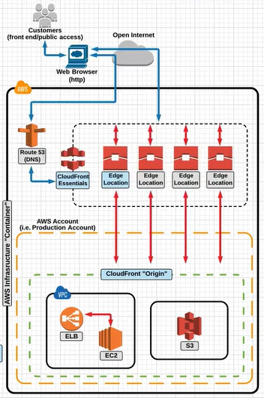
CloudFront Overview

Slide 3
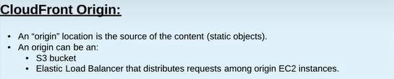
CloudFront Origin

Slide 4
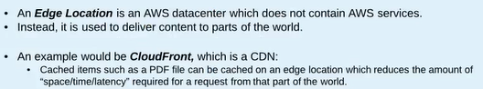
Edge Location

Slide 5
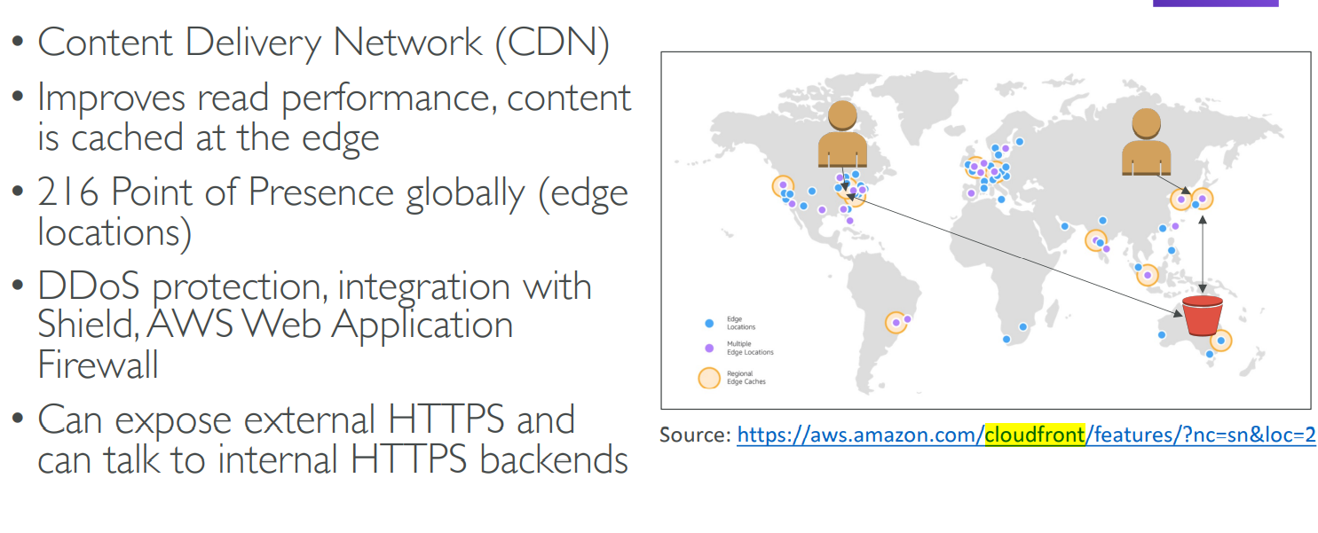
AWS CloudFront

Slide 6
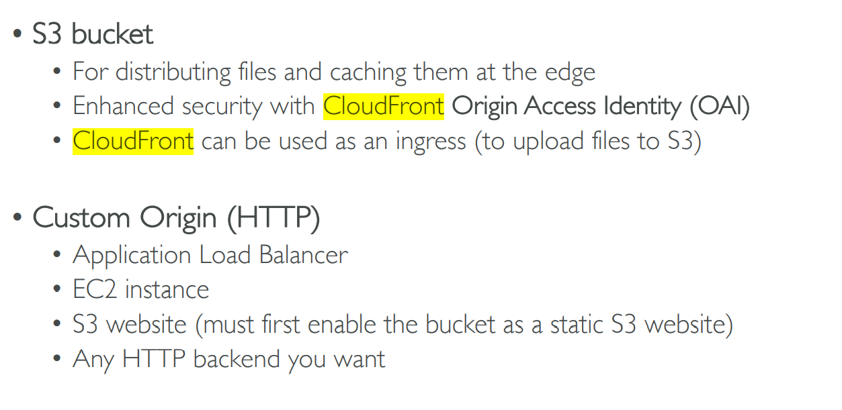
CloudFront Origins

Slide 7
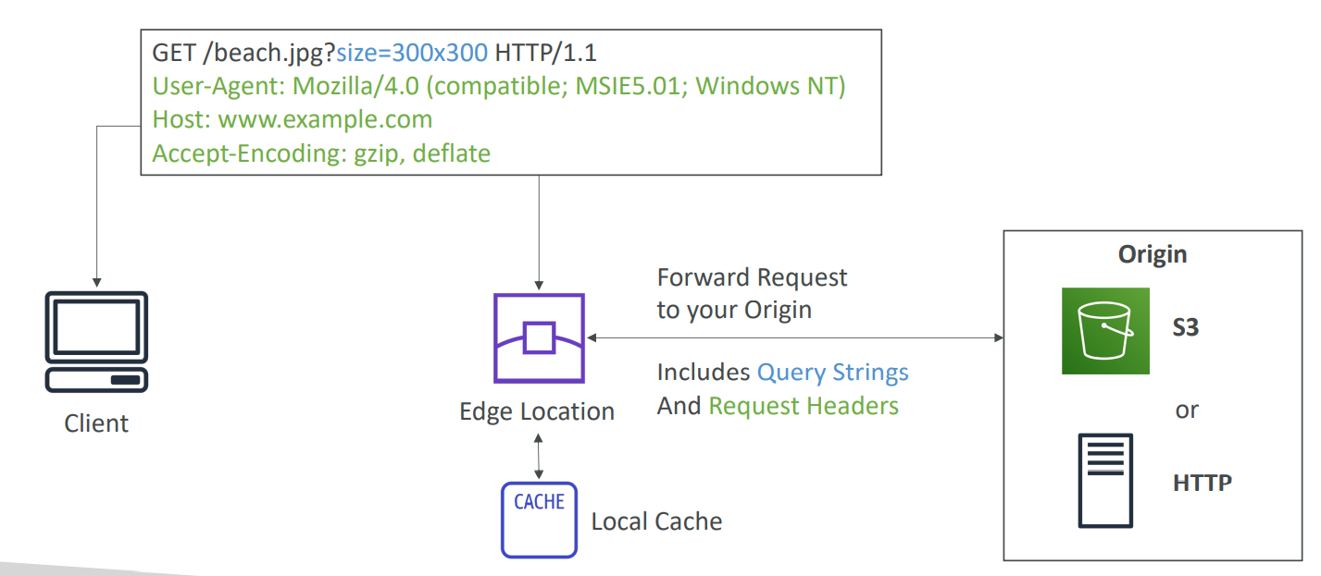
CloudFront at a high level

Slide 8
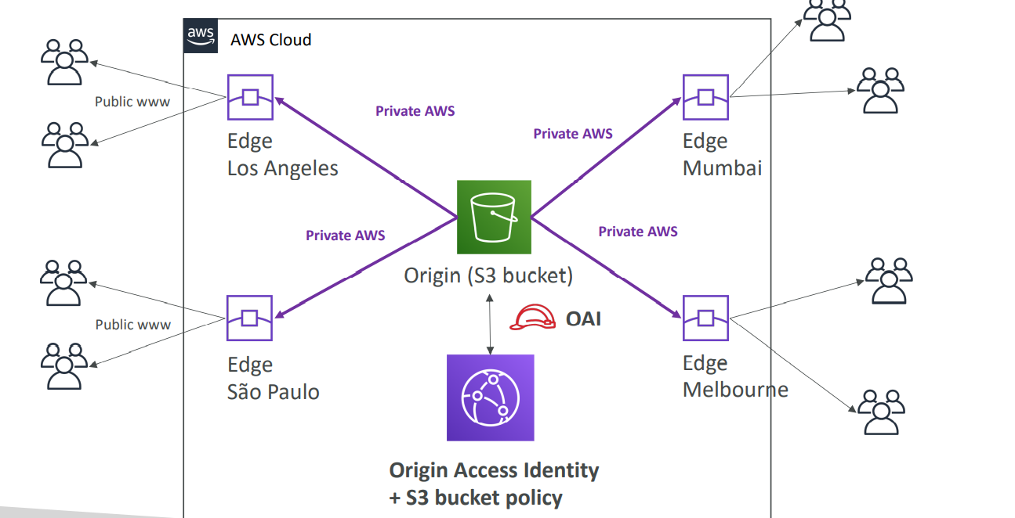
CloudFront – S3 as an origin

Slide 9
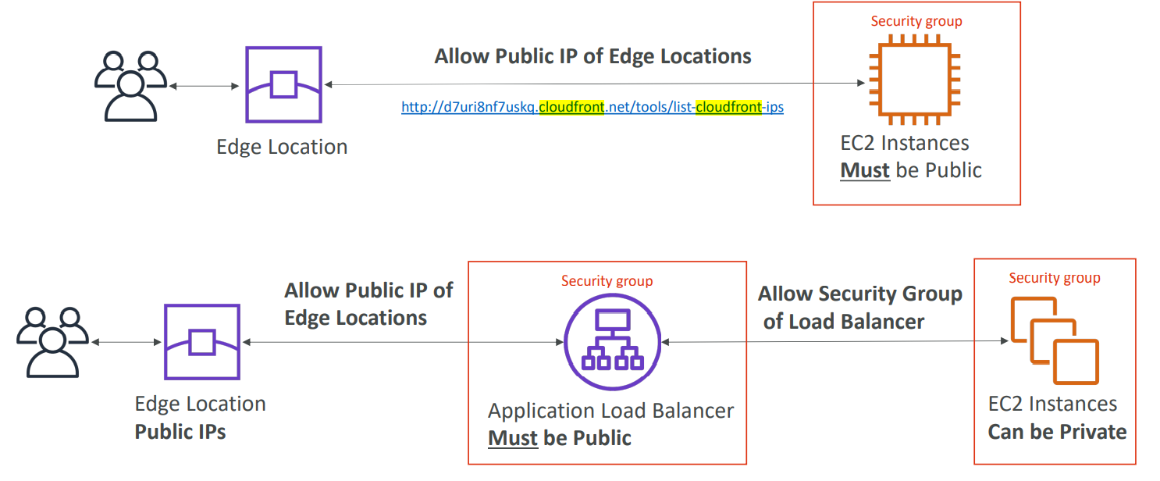
CloudFront – ALB or EC2 as an origin

Slide 10
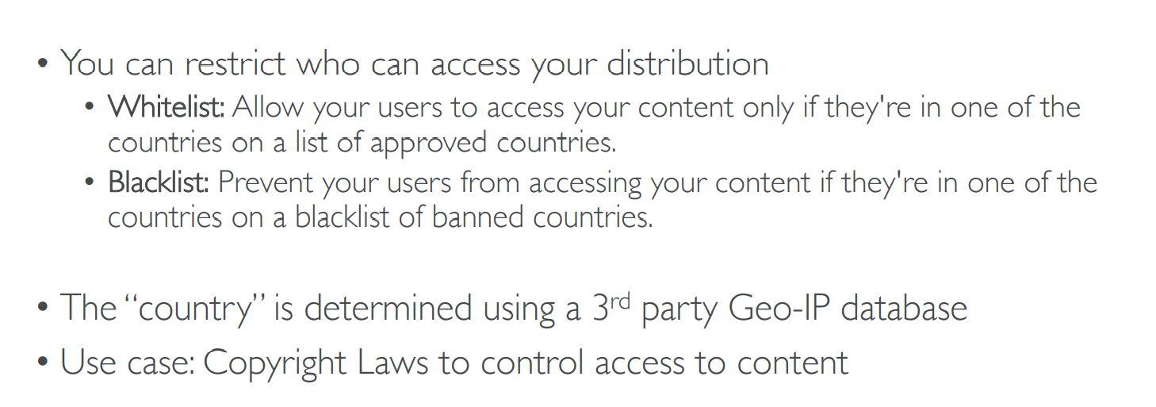
CloudFront Geo Restriction

Slide 11
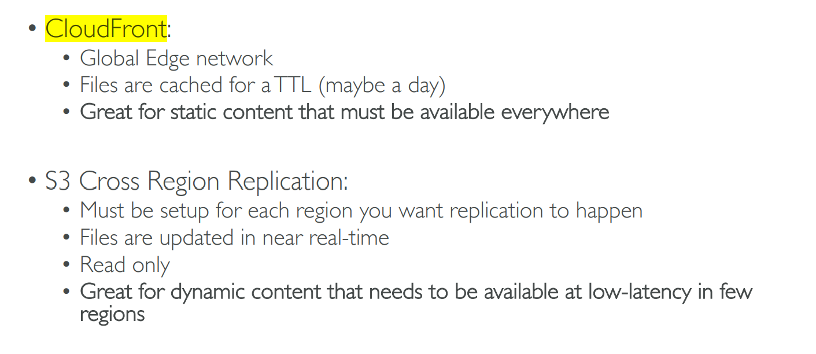
CloudFront vs S3 Cross Region Replication

Slide 12
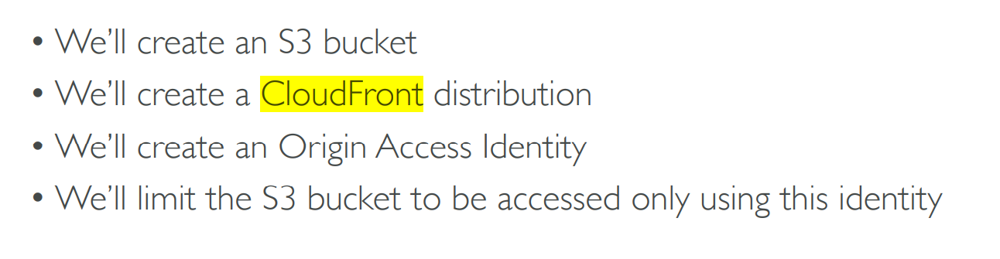
Hands on

Slide 13
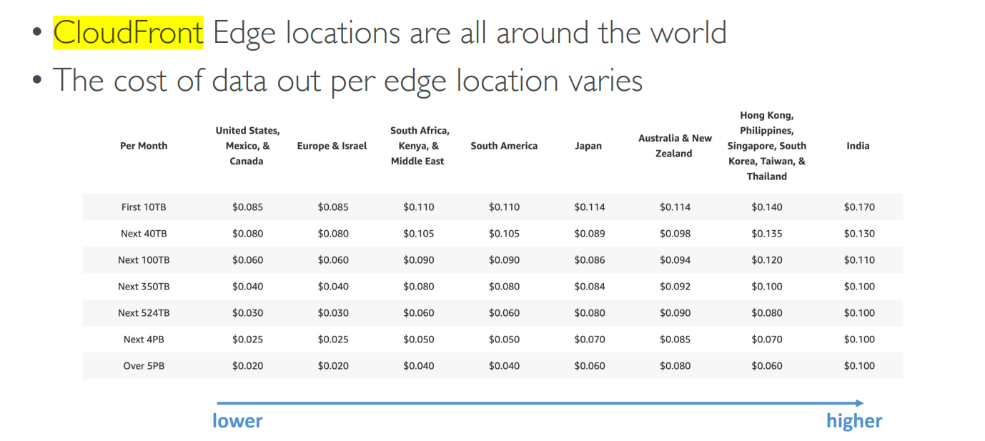
CloudFront- Pricing

Slide 14
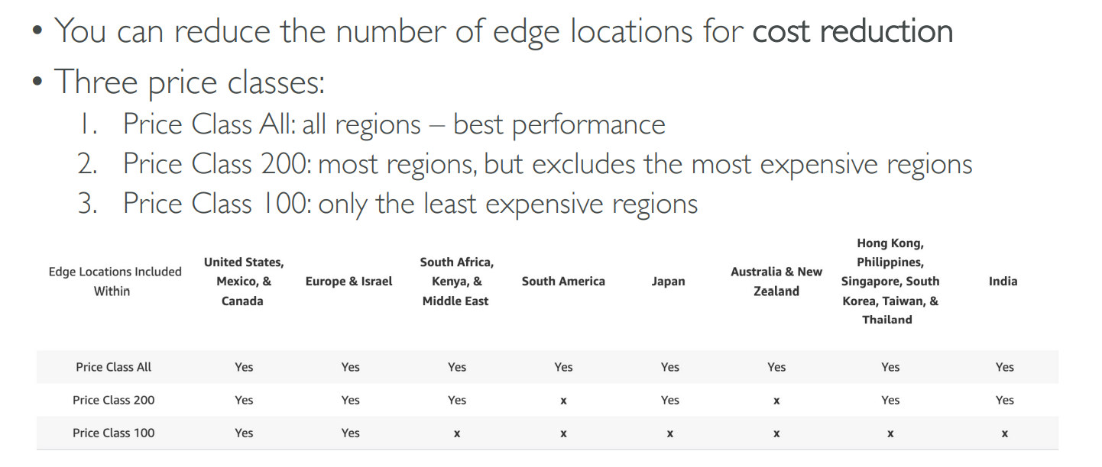
CloudFront – Price Classes

Slide 15
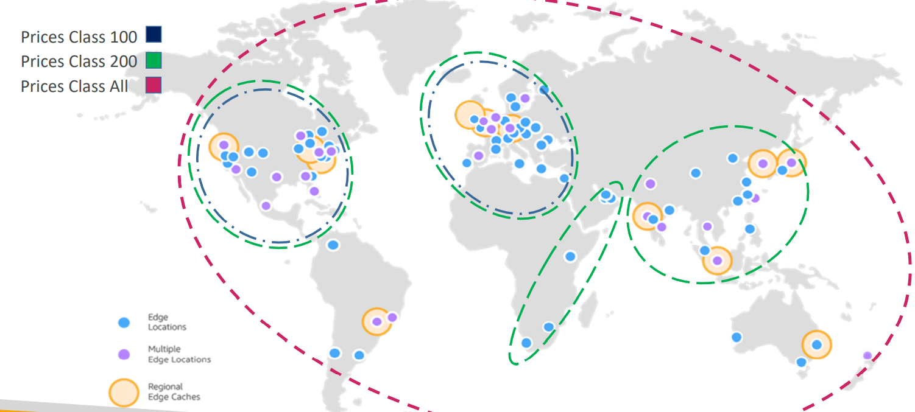
CloudFront – Price Class

Slide 16
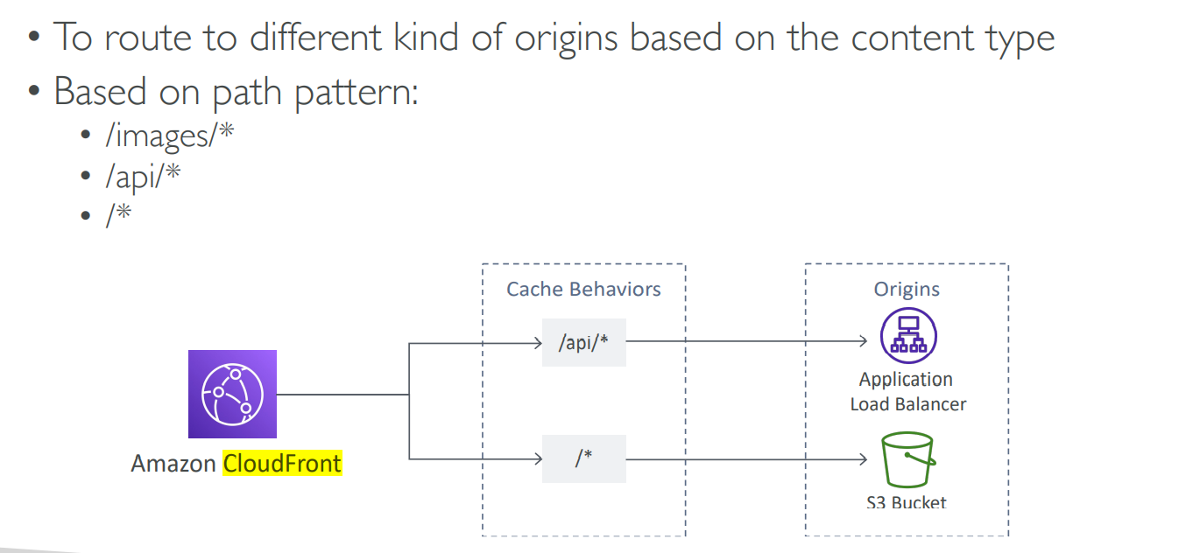
CloudFront – Multiple Origin

Slide 17
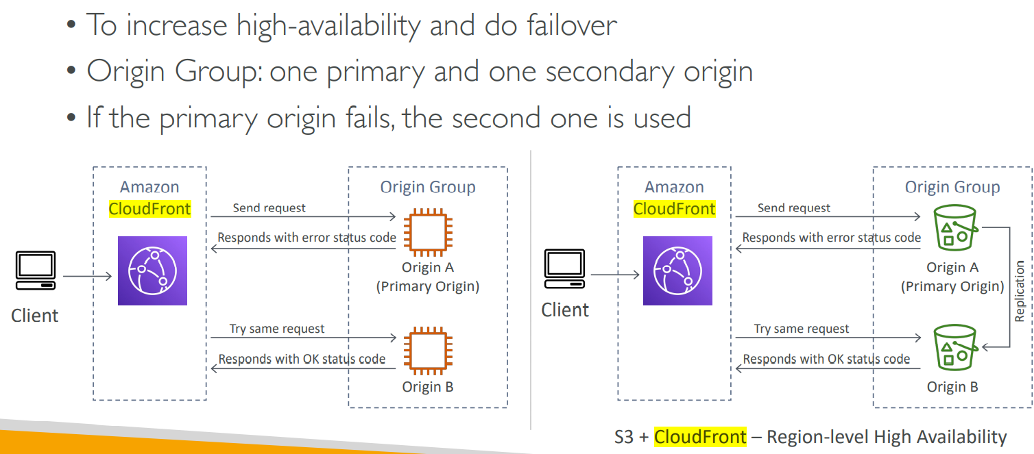
CloudFront – Origin Groups

Slide 18
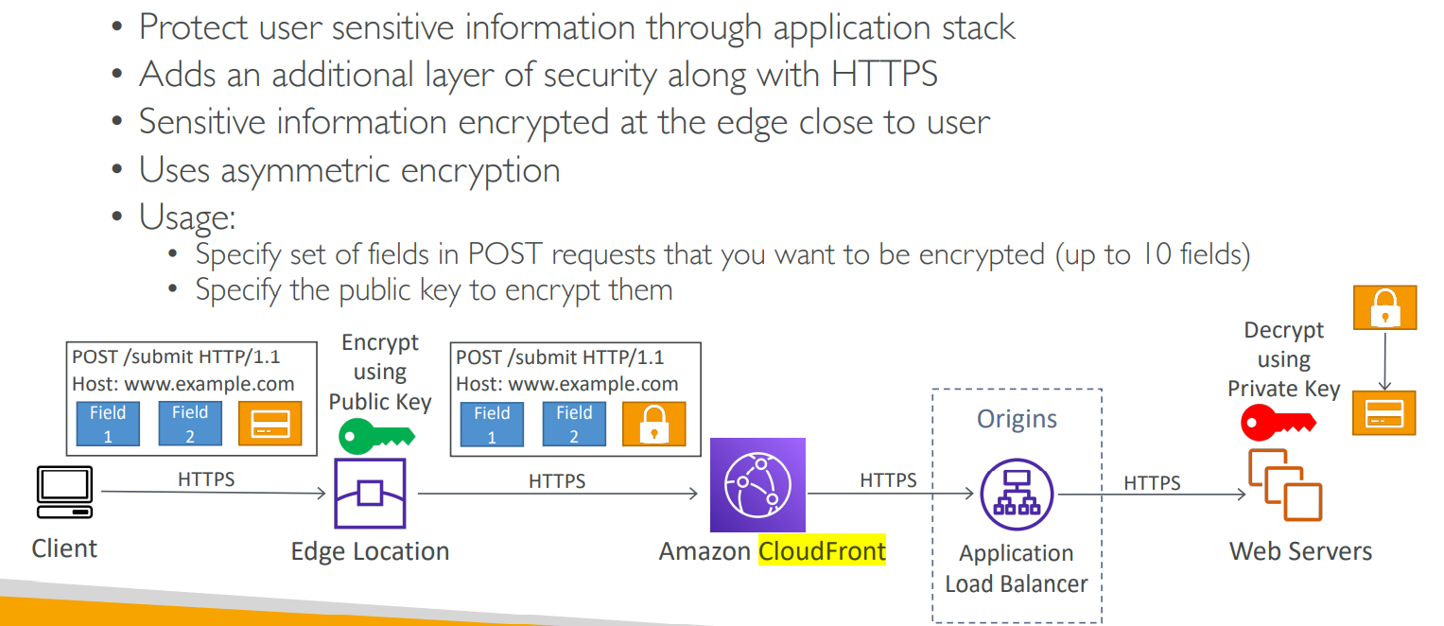
CloudFront – Field Level Encryption

Slide 19
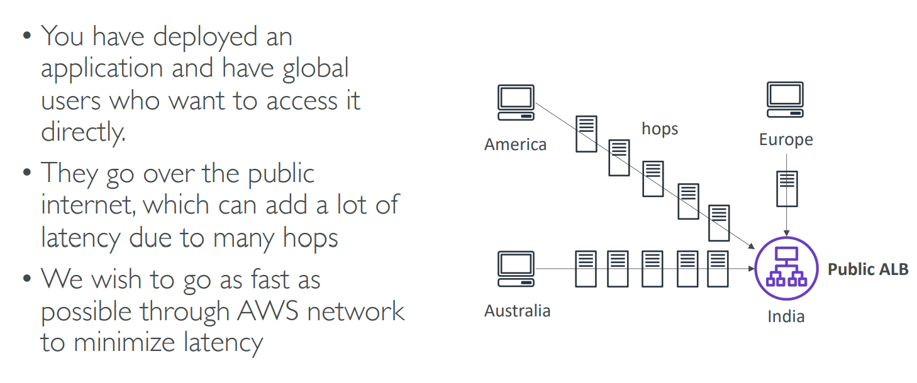
Global Users for our application

Slide 20
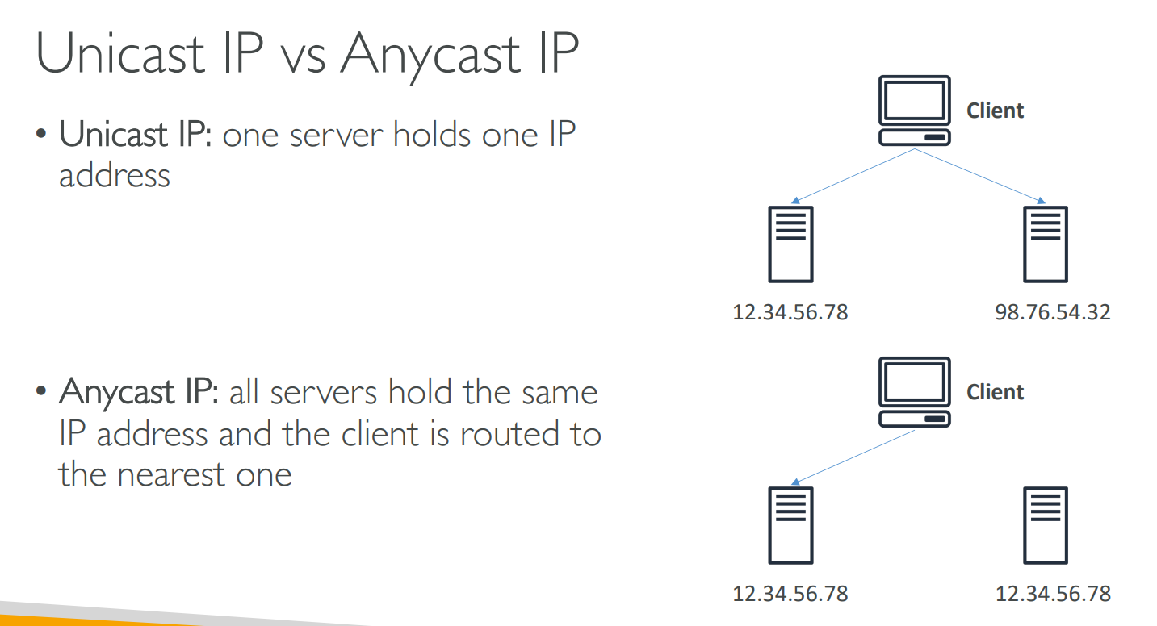
Unicast vs Anycast IP

Slide 21
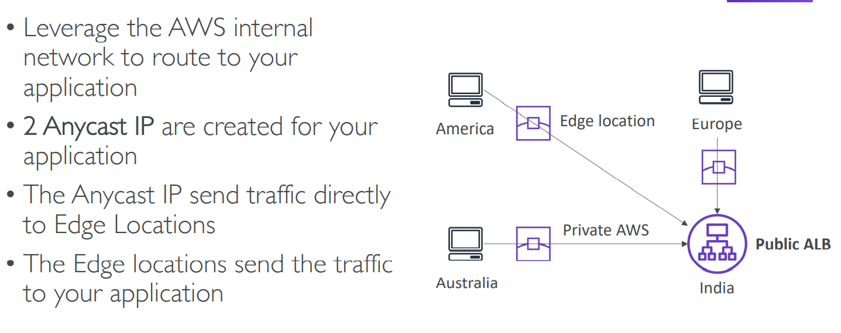
AWS Global Accelerator

Slide 22
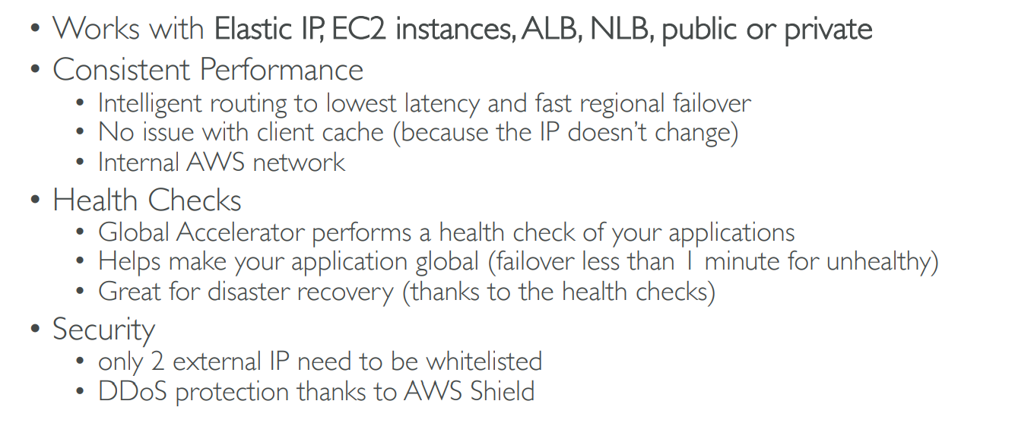
AWS Global Accelerator

Slide 23
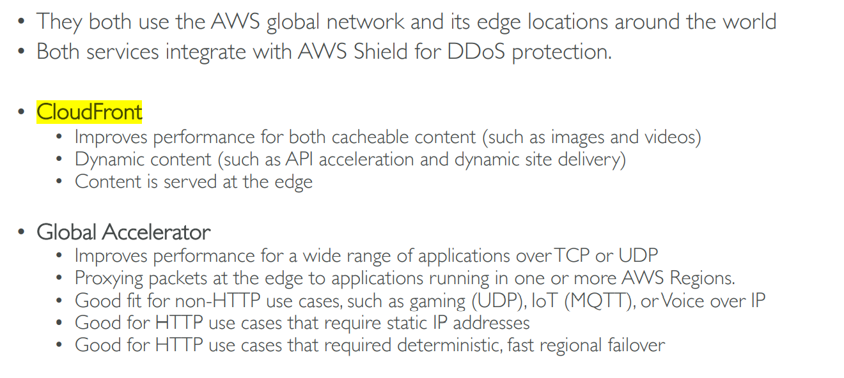
AWS Global Accelerator vs CloudFront

Slide 24
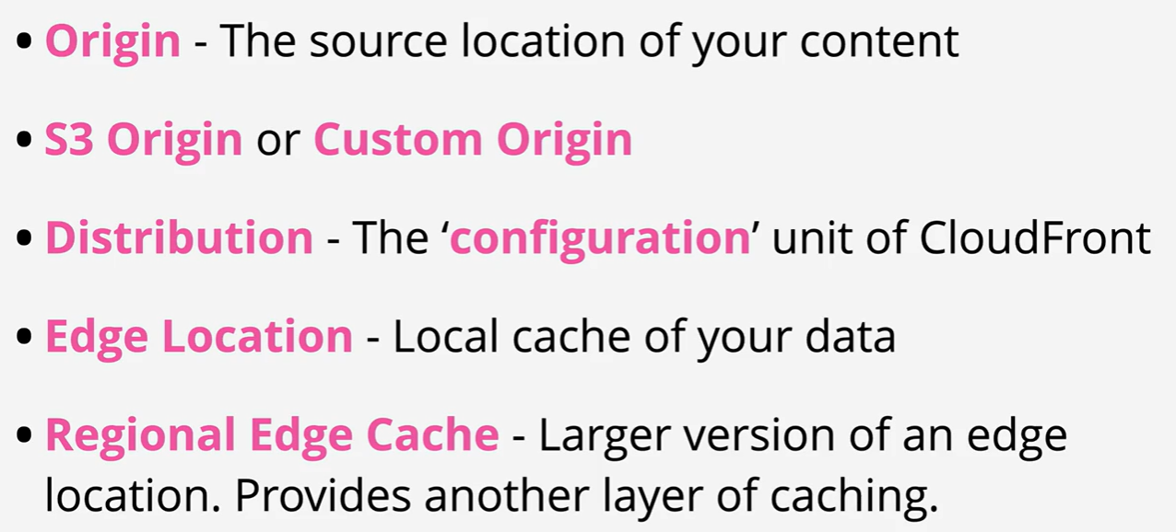
CloudFront Terms

Slide 25
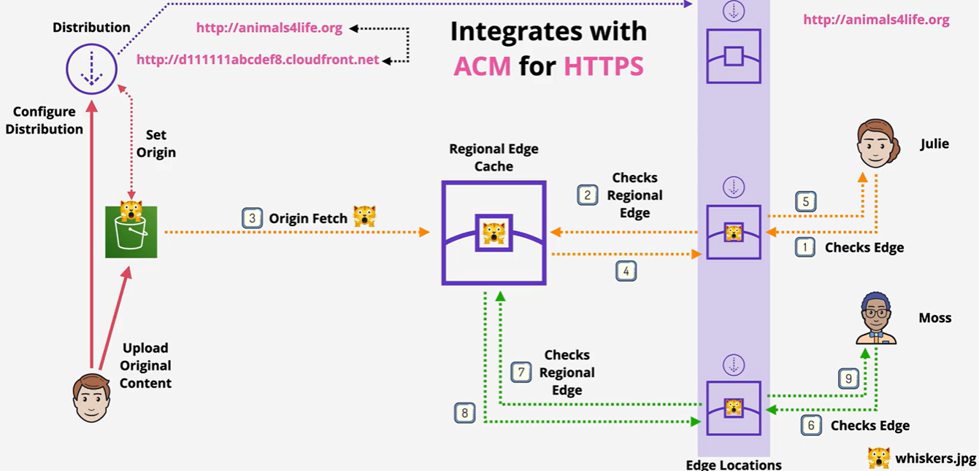
CloudFront Architecture

Slide 26
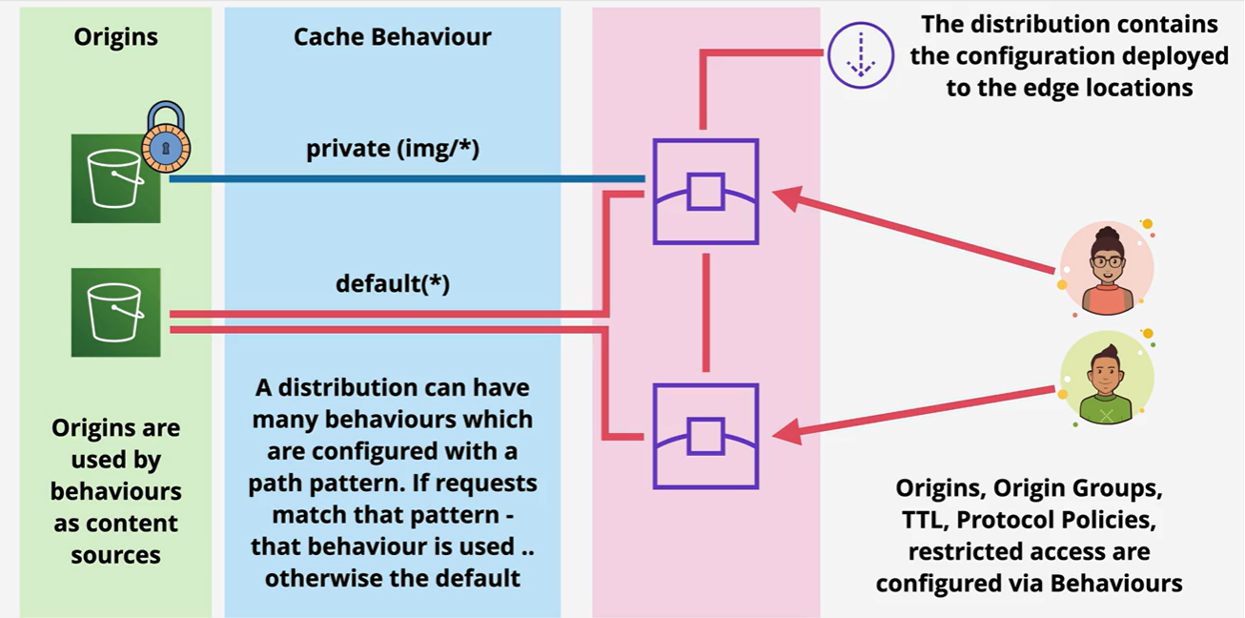
CloudFront Architecture

Slide 27
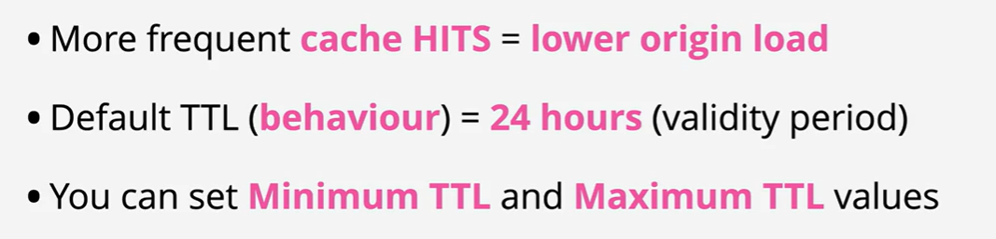
TTL and Invalidations

